Slide 1

Sentiment Analysis of Customer Reviews
Machine Learning & NLP with Streamlit Deployment

Slide 2
Introduction
📌 Content:
Why do customer reviews matter?
90% of consumers read online reviews before making a purchase.
Companies use reviews for product improvements & marketing strategies.
Challenges with manual analysis:
Millions of reviews → Too large for manual processing.
Subjectivity & bias → Varies between individuals.
Solution:
Use Machine Learning & NLP to classify sentiments automatically.

Slide 3
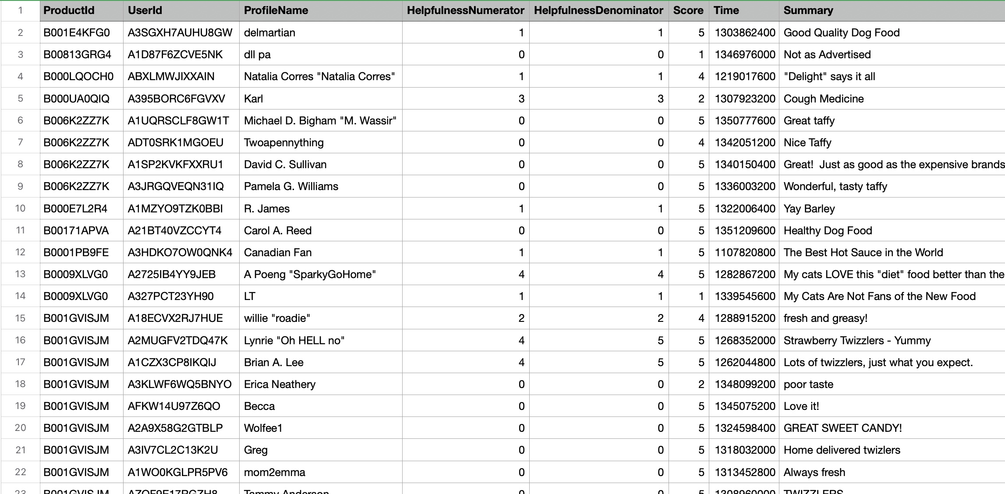
Dataset Overview
📌 Dataset: Amazon Product Reviews Dataset (~568,454 records)

Slide 4
Key Features
Feature | Description
Id | Unique identifier for each review
ProductId | Unique identifier for the product
UserId | Unique identifier for the reviewer
ProfileName | Name of the reviewer
HelpfulnessNumerator | Number of helpful votes
HelpfulnessDenominator | Total votes for helpfulness
Score | Rating (1 to 5)
Summary | Short review title
Text | Full review content
Sentiment Labels | Positive (Score > 3) Negative (Score ≤ 3)

Slide 5
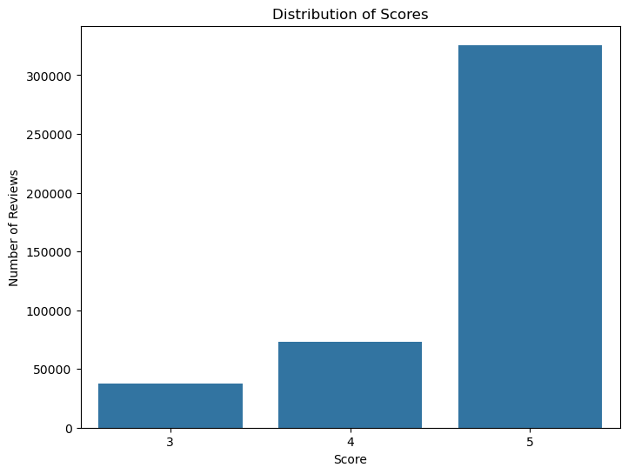
Bar Chart

Slide 6

EDA Analysis
Sentiment Distribution:
~70% reviews are Positive
~30% reviews are Negative
Most Common Words Used in Reviews.
Average Review Length Analysis

Slide 7
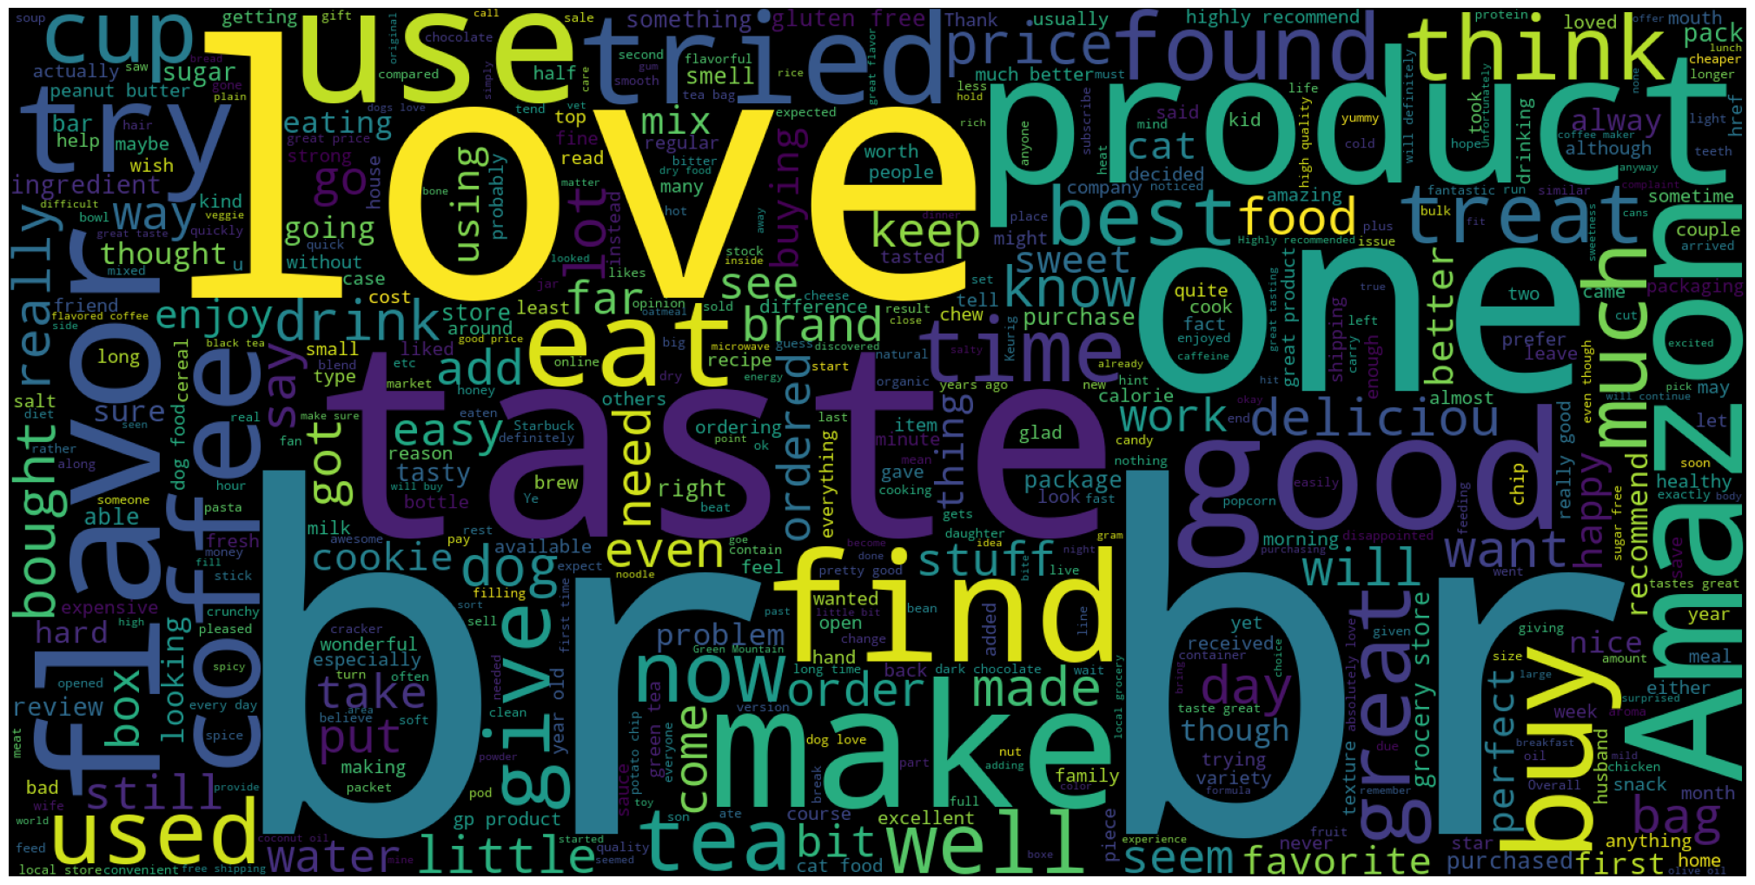
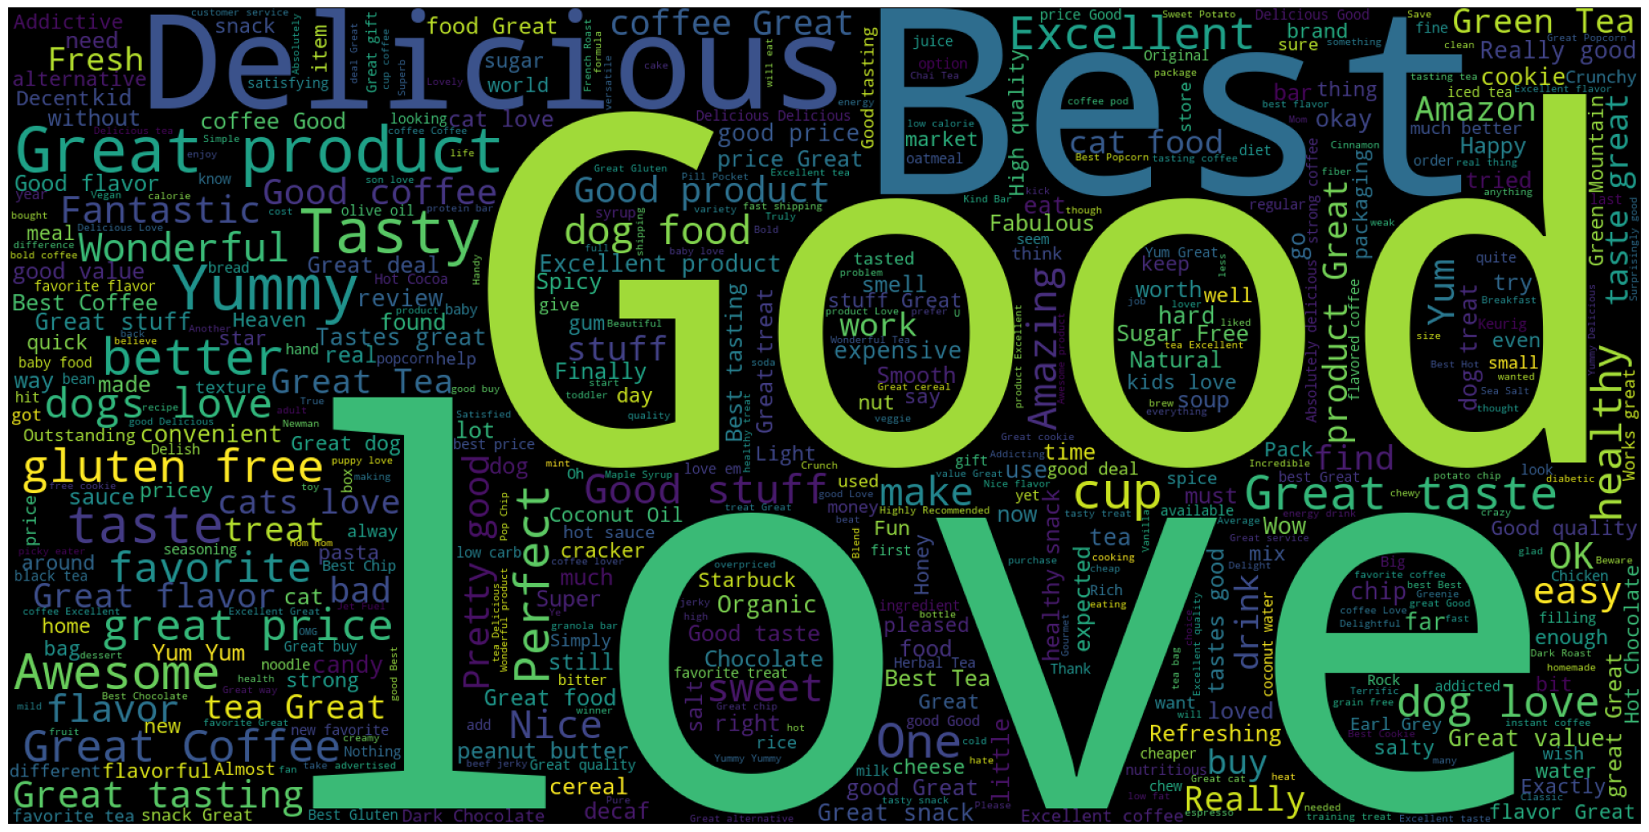
Word Cloud

Slide 8
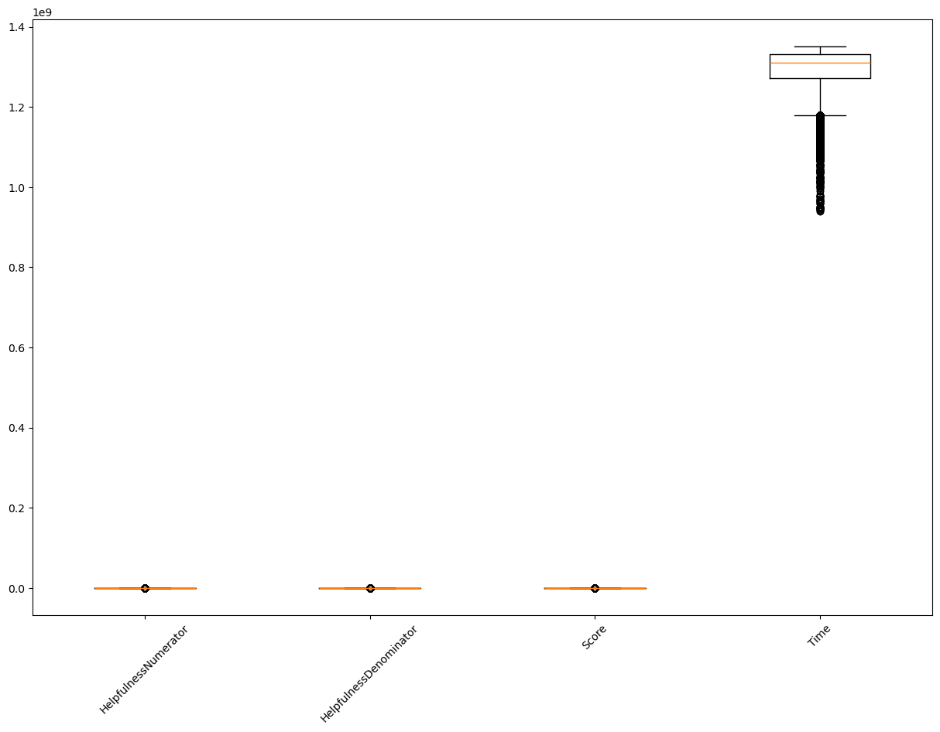
Boxplot

Slide 9
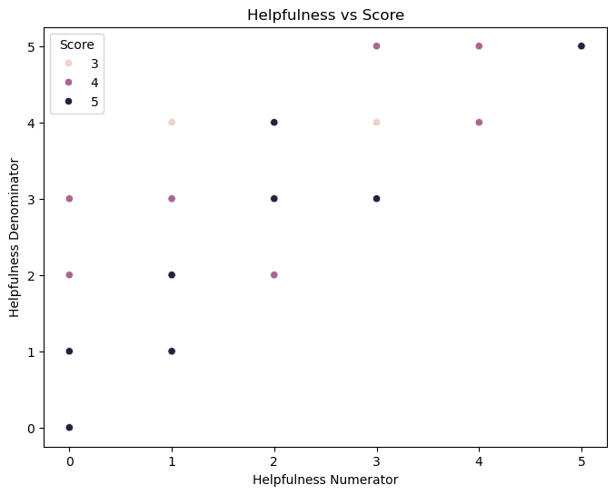
Scatterplot

Slide 10
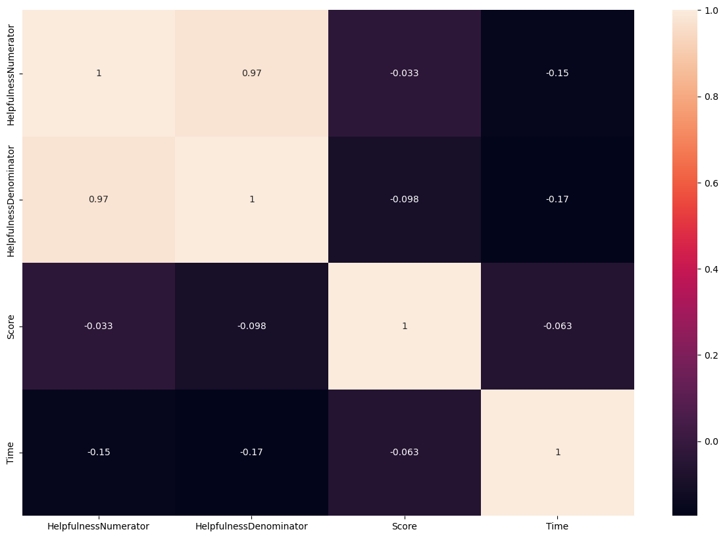
Heat Map

Slide 11
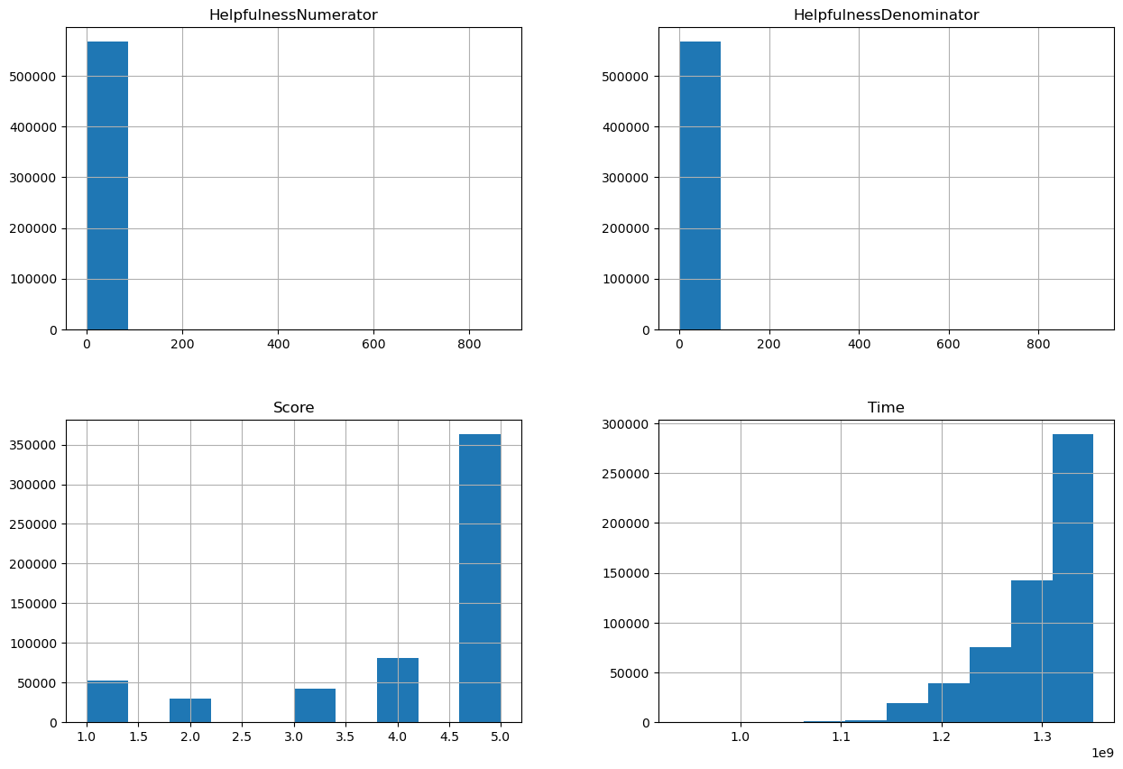
Histogram of Different Factors

Slide 12
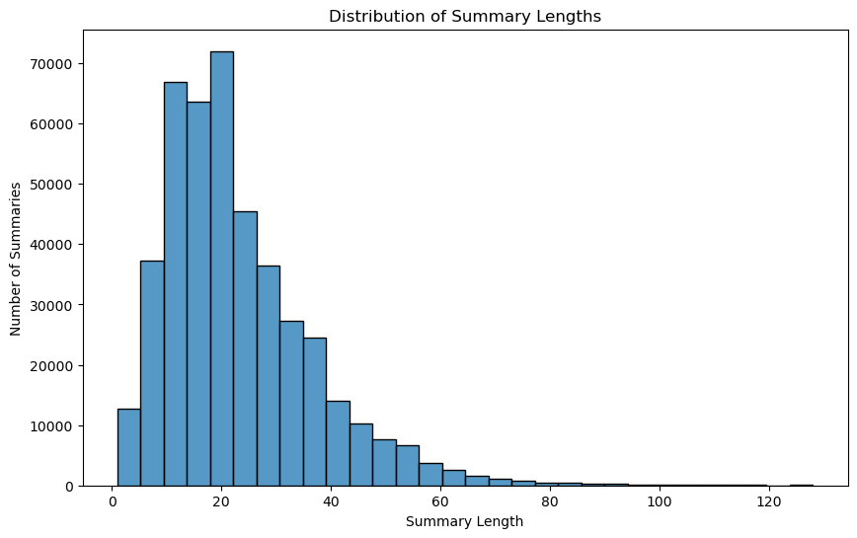
Histogram of Review Lengths

Slide 13

Data Preprocessing & Feature Engineering
📌 Steps Taken:
✅ Text Cleaning:
Removed stopwords, punctuation, special characters.
✅ Tokenization & Lemmatization.
✅ TF-IDF Vectorization for Feature Extraction.
✅ Convert Scores into Binary Sentiment Labels.

Slide 14

Machine Learning Models Used
📌 Models Implemented:
• Logistic Regression
• Support Vector Machine (SVM)
• Decision Tree Classifier
• Random Forest Classifier
• XGBoost
• Stochastic Gradient Descent (SGD)

Slide 15
Model Performance Comparison
Model | Accuracy | Precision | Recall | F1-score
Logistic Regression | 85% | 84% | 85% | 85%
SVM | 88% | 87% | 88% | 88%
Random Forest | 87% | 86% | 87% | 87%
XGBoost | 90% | 89% | 90% | 90%
Decision Tree | 82% | 80% | 82% | 81%

Slide 16
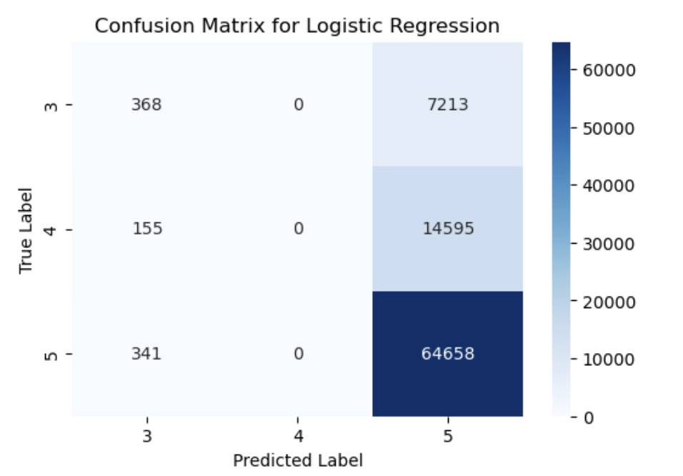
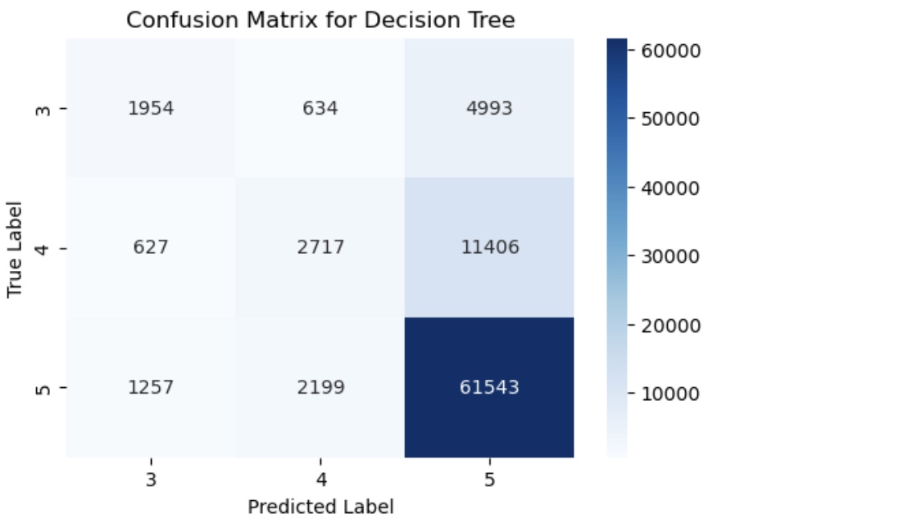
Confusion Matrix

Slide 17
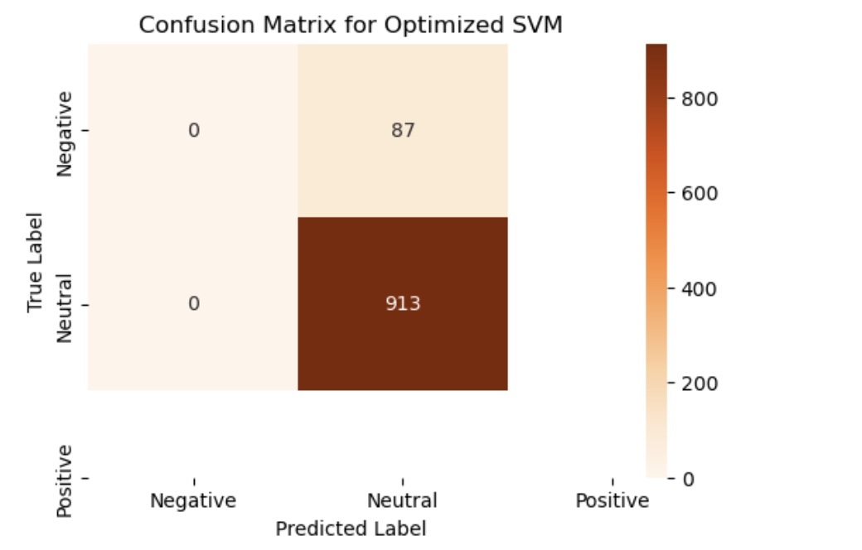
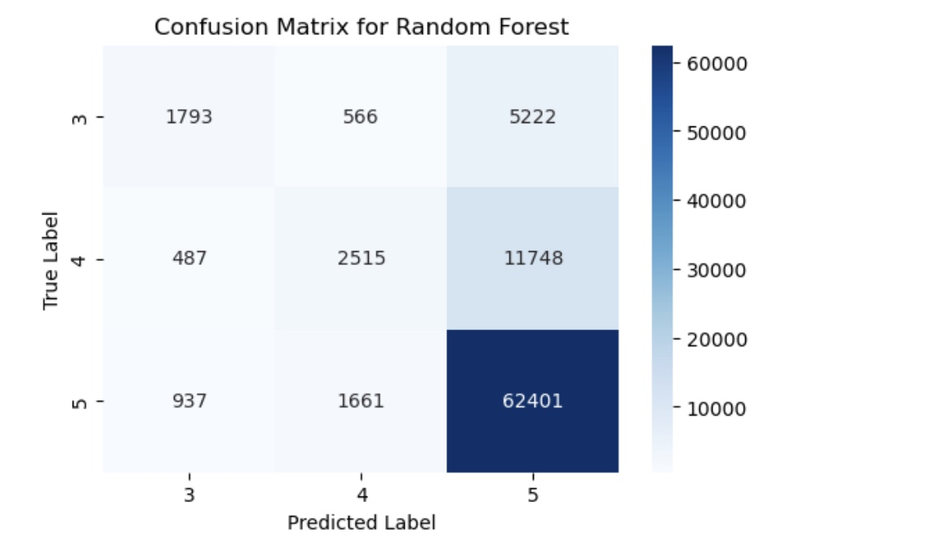
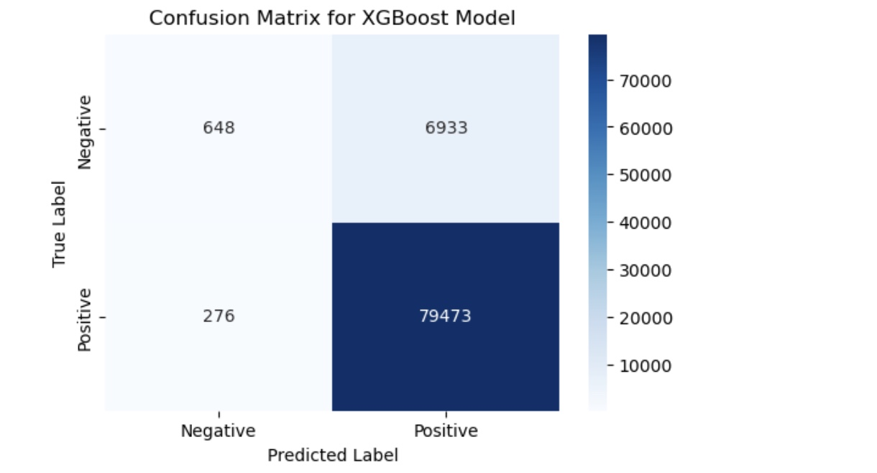
Confusion Matrix

Slide 18

Deployment with Streamlit
📌 Web App Features:
Model selection dropdown.
Confusion matrix visualization.
Sentiment classification.

Slide 19
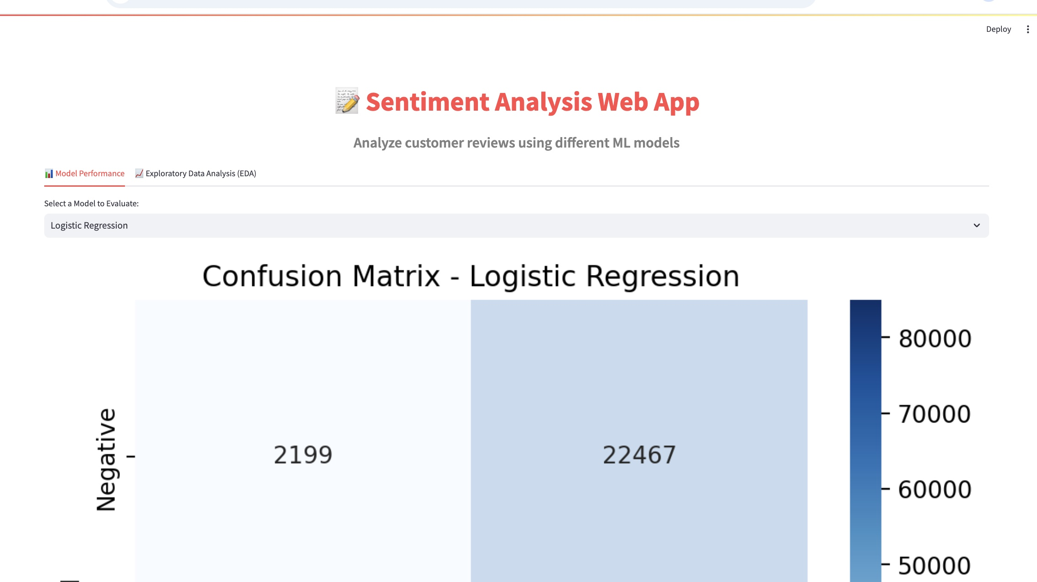
Deployment with Streamlit

Slide 20
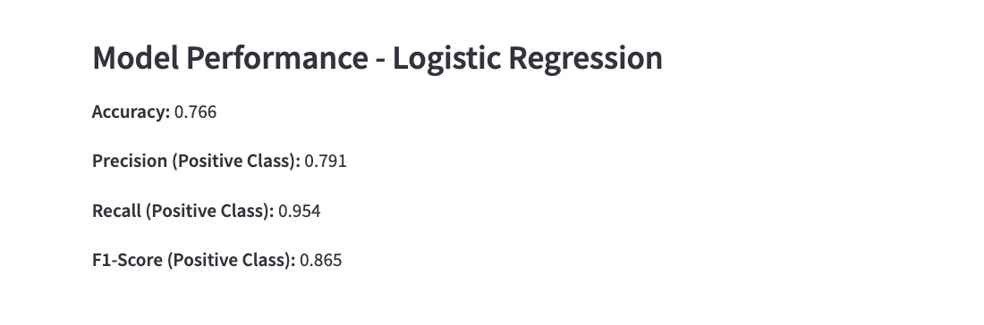
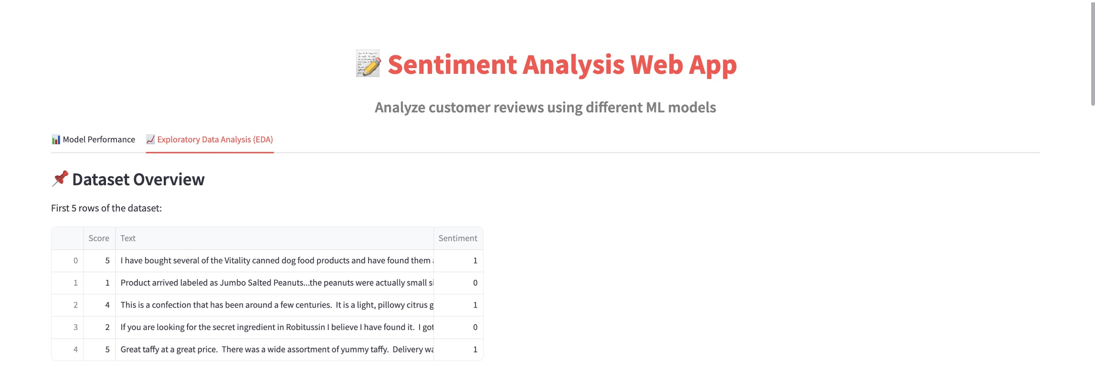
Deployment with Streamlit

Slide 21

Challenges Faced
📌 Challenges:
Large Dataset (~568K reviews).
Class Imbalance: More Positive Reviews.
Slow Performance in Streamlit Deployment.

Slide 22

Conclusion & Future Scope
📌 Key Takeaways:
XGBoost performed best.
Sentiment Analysis helps businesses understand customers.
📌 Future Scope:
Implement Deep Learning (LSTMs, Transformers).
Optimize real-time processing.

Slide 23

Thank You !

